Slide 1
CS 31007 Autumn 2019 COMPUTER ORGANIZATION AND ARCHITECTURE
Instructors
Section I - Rajat Subhra Chakraborty
Class Room NR 423
Section II - Bhargab B. Bhattacharya
Class Room NR 124
Indian Institute of Technology Kharagpur
Computer Science and Engineering
Notes:
Good Morning!
The title of today’s talk is “On some Planar Partitioning Problems”.

Slide 2
Today’s agenda
Overview of the course
Evolution and history of computer design
Moore’s law
Basic components of a computer
Instruction Set Architecture (ISA)
Computer organization and computer
architecture: Bottom-up and Top-down view
Acknowledgement: Patterson and Hennessy; V. D. Agrawal; S. R. Sarangi
Notes:
Good Morning!
The title of today’s talk is “On some Planar Partitioning Problems”.

Slide 3
CS 31007 Autumn 2019 COMPUTER ORGANIZATION AND ARCHITECTURE
Class Schedule
12:00-12:55 (Mon), 10:00-11:55 (Tue), and 8:00-8:55 (Thurs)
Tutorial class will be held on every Thursday
Lab Course (39001): Computer Organization Laboratory
Prerequisites
Basic logic design, combinational and sequential circuits,
knowledge of high-level programming language
Notes:
Good Morning!
The title of today’s talk is “On some Planar Partitioning Problems”.

Slide 4
CS 31007 Autumn 2019 COMPUTER ORGANIZATION AND ARCHITECTURE
Prerequisites
Basic logic design, combinational and sequential circuits,
knowledge of high-level programming language
Announcement
Pre-Requisite In-Class Quiz: Monday, 22 July 2019
12:00-12:55 (Open-Book, Open-Notes)
Notes:
Good Morning!
The title of today’s talk is “On some Planar Partitioning Problems”.

Slide 5
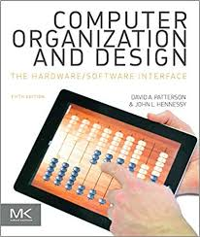
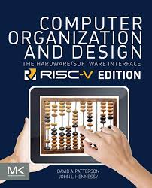
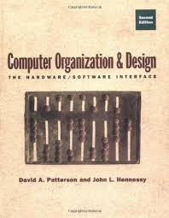
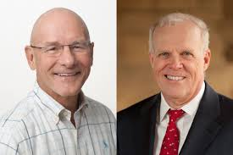
Textbook:
1. D. A. Patterson and J. L. Hennessy, Computer Organization and Design - the Hardware
Software Interface, 5th Edition, Elsevier, Morgan Kaufmann, 2014.
2. Older Editions of the same book [2nd Ed. (1998), 3rd Ed. (2005), 4th Ed. (2012)], and newer
RISC V (2018) Edition may also be referred to while discussing some topics).
Textbook
D. A. Patterson and J. L. Hennessy Computer Organization and Design
- The Hardware Software Interface
5th Edition, Morgan Kaufmann, 2014
RISC-V Edition 2018
Second Edition 1998
2017 ACM Turing Award

Slide 6
Further Reading
Smruti R. Sarangi, Computer Organisation and Architecture,
McGraw Hill India, 2014
2. William Stallings, Computer Organization and Architecture:
Designing for Performance, Eight Edition, Prentice Hall, 2010.
3. John P. Hayes, Computer Architecture and Organization,
3rd Edition, Tata McGraw Hill, 2012.

Slide 7
Grading Policy
Homework and Quiz for practicing
In-Class Quiz on Tutorial Days: 10% (=5 × 2)
Class-Test 1 and Class-Test 2: 10% (=2 × 5)
Mid-Sem Exam (2 hour): 30%; 16-24 Sept. 2019
End-Sem Exam (3 hour): 50%; 18-27 November 2019

Slide 8
Goal is to understand ….
What are the principles of computer design?
What is the hardware-software interface?
What is computer organization and computer architecture?
How to design the instruction set of a machine?
How instructions are executed in a machine?
What are the techniques for performing fast computation?
How a complete processor is designed?

Slide 9
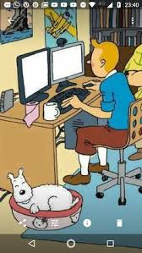
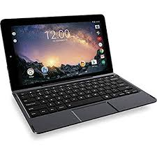
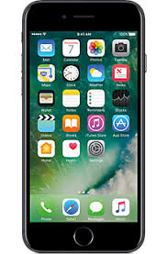

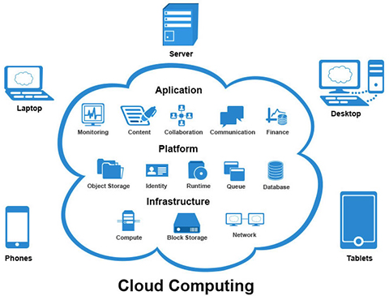
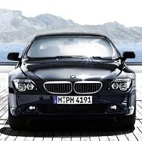
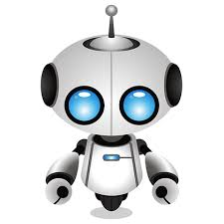
What is a Computer ?
9

Slide 10
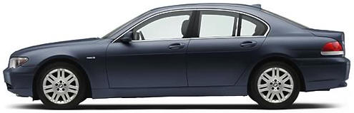
Car or Computers?
BMW 345i
2,000,000 lines of code
Fiftythree 8-bit microprocessors
Eleven 32-bit microprocessors
Seven 16-bit microprocessors

Slide 11
The Computer Revolution
§1.1 Introduction
Makes novel applications feasible
Computers in automobiles
Cell phones
Human genome project
World Wide Web
Search Engines
Computers are pervasive

Slide 12
Classes of Computers
Personal computers
General purpose, variety of software
Subject to cost/performance tradeoff
Server computers
Network based
High capacity, performance, reliability
Range from small servers to building sized

Slide 13
Classes of Computers
Supercomputers
High-end scientific and engineering calculations
Highest capability but represent a small fraction of the overall computer market
Embedded computers
Hidden as components of systems
Stringent power/performance/cost constraints

Slide 14
A computer is a general purpose machine which can process
Information and yield results
However, centuries ago, by a
computer was meant …

Slide 15
The First Mechanical Computing Device
The nineteenth century Chinese abacus, numbers are entered by sliding the beads towards the crossbar.

Slide 16
First Steps in Computing
John Napier (1550-1617)
The front page of Napier’s famous paper (1614) that introduced logarithm and contained ninety pages of tables.

Slide 17
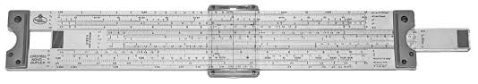
Slide Rule
The first slide rule (top left) was made in 1654; the cylindrical slide rule (below left) and circular slide rules are useful modifications that were used for various computations; Slide rule (left-bottom) used by early generation of engineers.

Slide 18
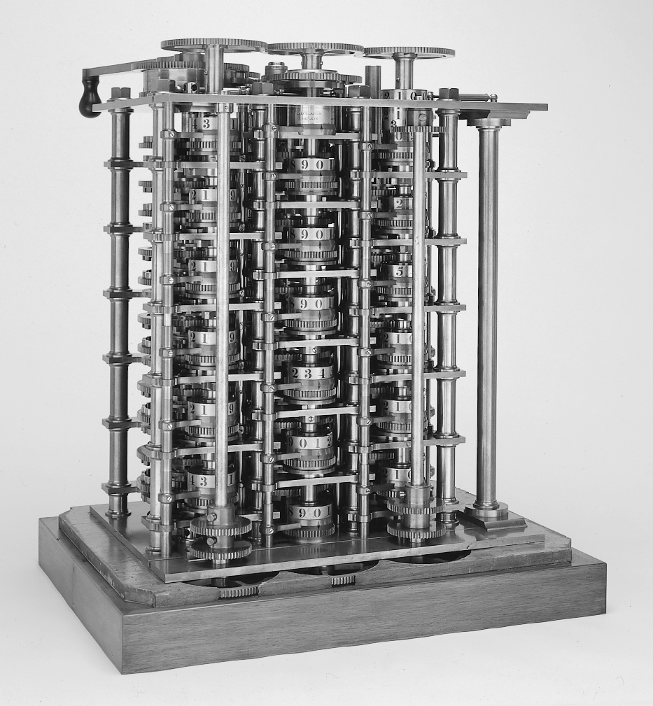
The First Computer (1832)
Babbage Difference Engine
25000 parts

Slide 19
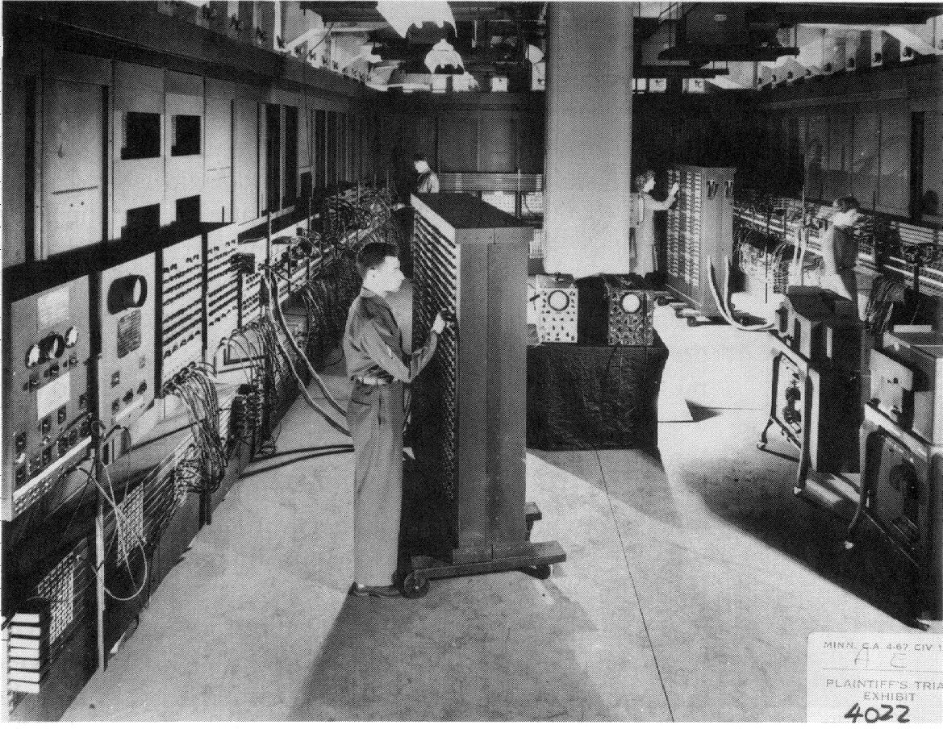
ENIAC - The First Electronic Computer
(1943-1946)
Length = 80 ft
Height =8.5 ft
Floor area = 1500 sq ft
Weight = 30 tons
18000 vacuum tubes
70,000 resistors
140 kw of power
John Mauchly (professor) and J. Presper Eckert (graduate student) built ENIAC at the University of Pennsylvania, Philadelphia

Slide 20
The Snapshots of ENIAC (1946)
A technician tracks down a misplaced cable in the ENIAC.
This advertisement shows the amazing calculating powers of the ENIAC
Courtesy: S. Augarten, Bit by Bit

Slide 21
The Miracle of Electronic Evolution
Battery??
No, an early 1024-bit memory!
No, an early binary adder:
built on a kitchen table!
An electrical relay network??

Slide 22
The First Integrated Circuit
An early integrated circuit made by Fairchild Corporation in 1961. This is a logic IC with two flip flops, the 4 blue structures in the center are transistors, and the white lines are aluminum connecters.

Slide 23
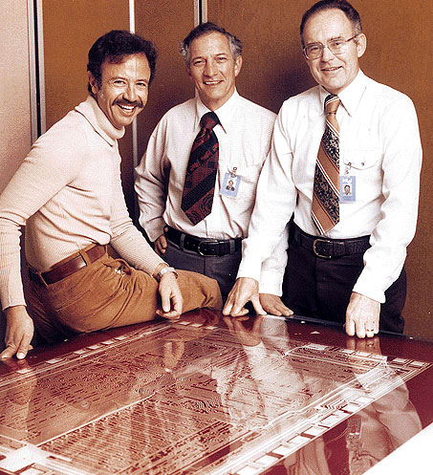
Hardware Design Creating History ……
Andy Grove, Robert Noyce, and Gordon Moore (1978)
Intel Founders

Slide 24
Entering the World of Microprocessors
Intel’s first advertisement for the 4004 microprocessor that appeared in November 1971.

Slide 25
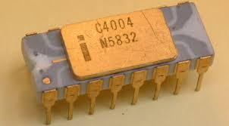
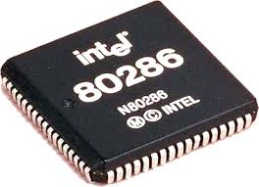
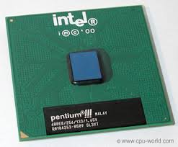
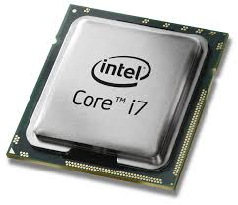
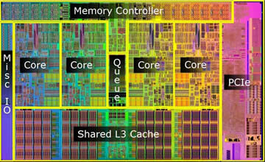
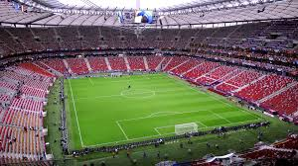
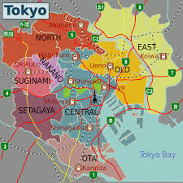
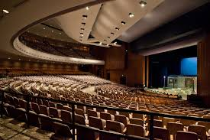
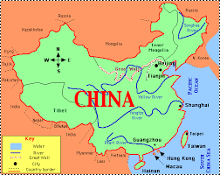

Evolution of Microprocessors
1970: 4004 μP
1982: 286 μP
1999: Pent III
2008: Core i7
#T = 32 million Population of Tokyo
#T = 2300 Auditorium
#T = 1,34,000 Stadium
#T = 1.3 billion Population of China
Number of transistors (#T)

Slide 26
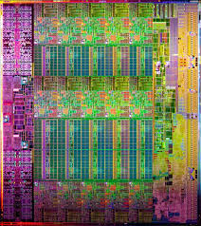
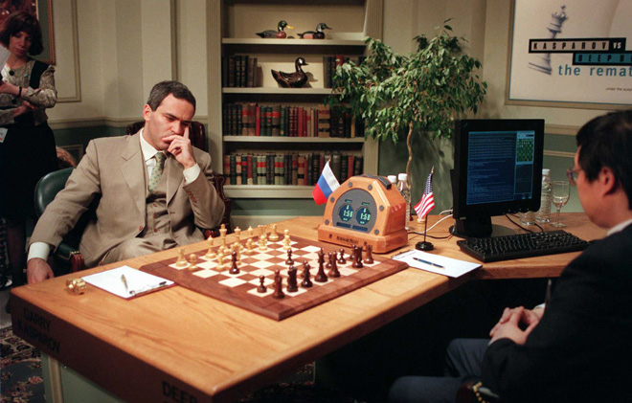
Modern Processors
Intel 15-Core Xeon Ivy Bridge-Ex (2014)
22 nm technology
4.3 billion transistors
Die size ~600 mm²
Intel Broadwell EP Xeon SoC (2016) – 7.2 billion T; 14 nm
IBM Deep Blue defeated Grand Master Garry Kasparov in May 1997

Slide 27
Gordon Moore: 1965
Progress in computer technology underpinned by Moore’s Law
Predicted that the number of transistors integrated on a die would grow exponentially (doubling every 12 to 18 months)
Million transistors/chip barrier crossed in the 1980s
Today:
Around several billion transistors per chip

Slide 28
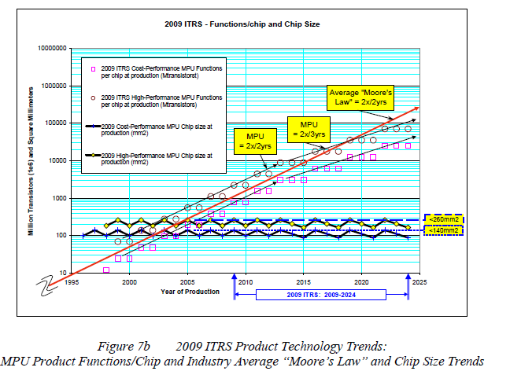
Transistor Count in a Chip
Courtesy: ITRS 2010

Slide 29
Example: Moore’s Law
Intel 80486
1.18 million T
Intel Xeon
SoC
7.2 billion T
1989
2016
1989
2016
$ 900
1 c
New York
Flight
Paris
New York
Flight
Paris
7 hours
0.25 sec

Slide 30
Computers of the Future …

Slide 31
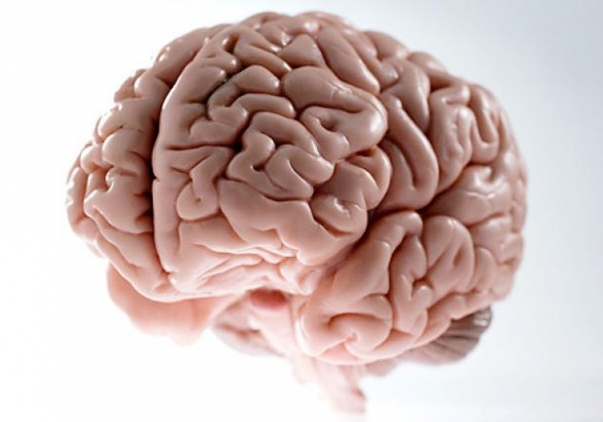
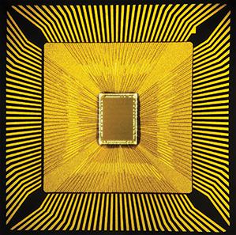
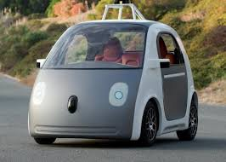
Neuromorphic Chips
bridging the gap between artificial and natural computation
Advances in neuroscience and chip technology now enable to process data in a similar way like brain. These “neuromorphic” chips will play chess, drive cars reliably in all conditions, and empower smartphones to act as personal assistants.

Slide 32
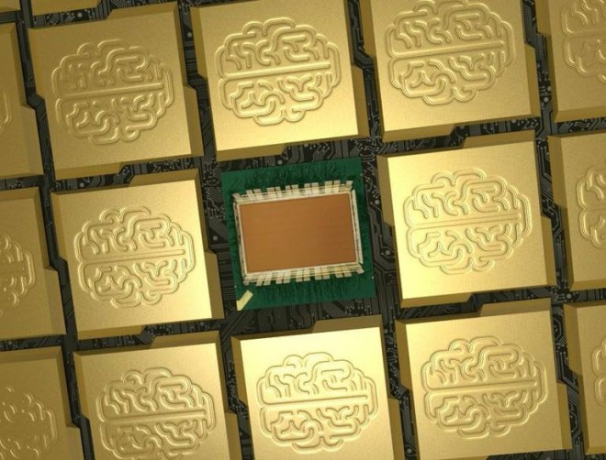
Neuromorphic Chips
bridging the gap between artificial and natural computation
IBM TrueNorth has 4,096 processor cores, which mimic one million human neurons and 256 million synapses, two of the fundamental biological building blocks that make up the human brain.
This IBM chip can encode data as patterns of pulses, which is similar to one of the many ways neuroscientists think the brain stores information.
Recognizes people, cyclists, cars, buses, and trucks with about 80 percent accuracy.
Do not separate processor & memory
Burns only 63 mW of power to process streaming video with 30 frames per sec.
SyNAPSE (Systems of Neuromorphic Adaptive Plastic Scalable Electronics) project - 2014

Slide 33
Google and IBM Announce
Quantum Computers (2015 - 2019)
These processors will work on sub-atomic levels based on the principles of quantum mechanics making them much faster
Technology could one day lead to machines able to think for themselves

Slide 34
Building a Computer System ……
Courtesy: Satyajit Ray

Slide 35
Computing System Hierarchy
Can understand high-level language, e.g.,
If X then C= A+B, else C= A-B
Application
software
Assembler
Compiler
Computer
Architecture
Instruction Set Architecture
Bare Machine
(Collection of circuits)
semantic gap
Can understand symbolic assembly
language, e.g., add C, A, B
can understand only machine language – binary strings of 0’s and 1’s, (0101001100..) i.e., electrical off and on signals (Computer Organization)

Slide 36
Hardware-Software Interface
software
Instruction Set Architecture (ISA)
hardware
ISA: Collective attributes of the machine-language instruction set
Courtesy: Patterson and Hennessy

Slide 37
Hardware Hierarchy
CPU, RAM, Control, I/O
Flip-flops (memory), Registers,
Logic circuits
Logic gates – AND, OR, NAND
Transistors
(Semiconductor switches)

Slide 38
How a program is executed by a computer
Compiler
Assembler
binary machine code
00000000101000010000000000011000
00000000000110000001100000100001
10001100011000100000000000000000
10001100111100100000000000000100
10101100111100100000000000000000
10101100011000100000000000000100
00000011111000000000000000001000
Application software,
a program in C:
swap (int v[ ], int k)
{int temp;
temp = v[k];
v[k] = v[k+1];
v[k+1] = temp;
}
Compiler translates it to
assembly language program
of the target machine
swap;
muli $2, $5, 4
add $2, $4, $2
lw $15, 0 ($2)
lw $16, 4 ($2)
sw $16, 0 ($2)
sw $15, 4 ($2)
jr $31
Hardware
See pages 122-123
output

Slide 39
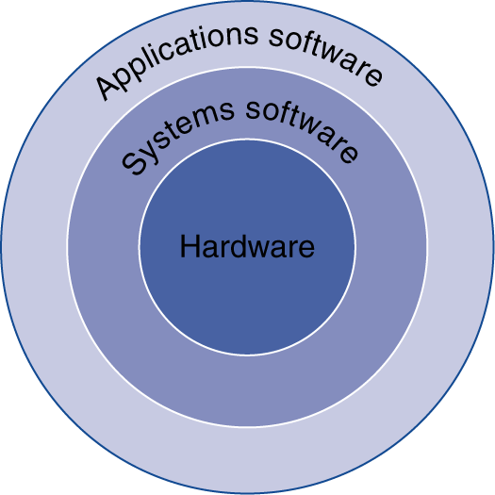
Below Your Program
Application software
Written in high-level language
System software
Compiler: translates HLL code to machine code
Operating System: service code
Handling input/output
Managing memory and storage
Scheduling tasks & sharing resources
Hardware
Processor, memory, I/O controllers
§1.3 Below Your Program

Slide 40
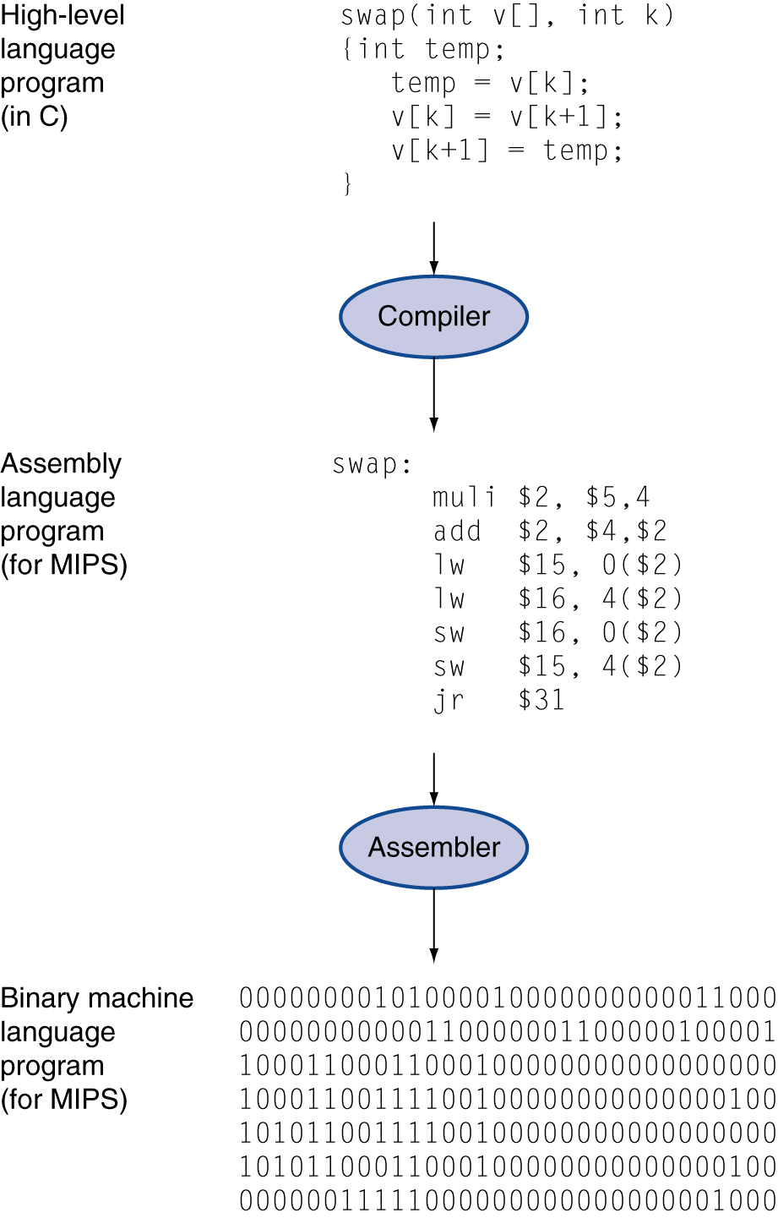
Levels of Program Code
High-level language
Level of abstraction closer to problem domain
Provides for productivity and portability
Assembly language
Textual representation of machine instructions
Hardware representation
Binary digits (bits)
Encoded instructions and data

Slide 41
Program Execution
Program written in high-level language, e.g., C
Question:
Where is the compiler running?
Who compiles the compiler?
How is the Assembler running?
Compilier
Assembly-language code
Assembler
Machine-language code (binary)
Hardware
Result

Slide 42
System Hierarchy
Applications
Application Software
Algorithms
Programming Language
System Software
Operating Systems, Compilers
Instruction Set Architecture (ISA)
Bare Machine
(Hardware)
Microarchitecture
Gates/Register-Transfer Level (RTL)
Circuits – Gates, Flip-flops
Devices - Transistors
Physics

Slide 43
Computer Organization versus Computer Architecture
Computer Architecture
The view of a computer as perceived by software designers
Instruction Set Architecture (ISA)
Computer Organization
The actual implementation of components in hardware

Slide 44
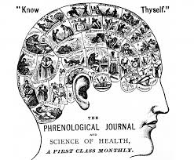
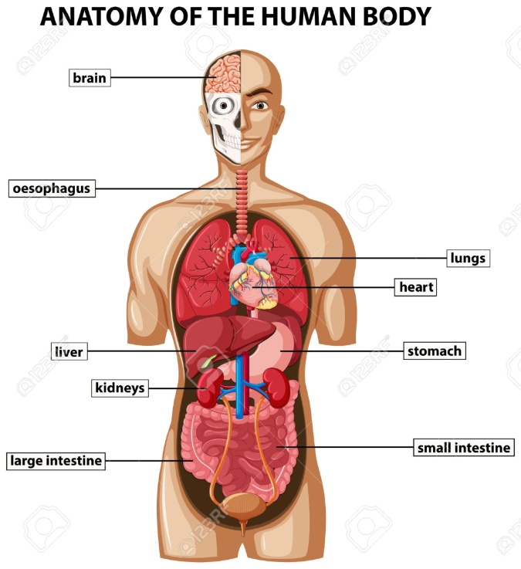
Computer Organization versus Computer Architecture
Computer Architecture: The personality of a machine
(behavioral view)
Instruction Set Architecture (ISA)
Computer Organization:
The anatomy of a machine
(structural view)

Slide 45
Computer Architecture
Architecture is visible to a programmer
Instruction set
Registers
Data representation, addressing modes
I/O mechanisms
Virtual view of memory

Slide 46
Computer Organization
Organization is visible to hardware designer
Hardware implementation of an instruction
Registers, program counter
Arithmetic and logical units
Control logic, internal states
Pipelining hardware
Cache and main memory

Slide 47
Computer Design Approach
System software
(OS, Compiliers)
System software
(OS, Compiliers)
Instruction Set Architecture (ISA)
Instruction Set Architecture (ISA)
Computer Organization
Computer Organization
Bottom-up approach:
Hardware first, ISA later
Top-down approach:
ISA first, hardware later

Slide 48
Instruction Set Architecture (ISA)
A set of assembly language instructions that separates the interface between software and hardware
In top-down design, given an ISA, an appropriate hardware platform is built to support it
Based on ISA, OS and compilers are to be developed accordingly further going up
Once ISA is fixed, software and hardware engineers can work independently
ISA is designed to optimize the performance supported by the available hardware technology.

Slide 49
The Hardware of a Computer
Application software
Systems software
Hardware
Registers
ALU
Memory
Control
I/O devices
Central Processing Unit (CPU)
Five easy pieces:
Control, Arithmetic Logic Unit (ALU), Memory, Input/Output, Datapath (Bus)

Slide 50
Next Class
Model for computation and Turing Machine
von Neumann Architecture
Basic Features of Instruction Set Architecture (ISA)
CPU Performance Equation
Amdahl’s Law
RISC versus CISC
Notes:
Good Morning!
The title of today’s talk is “On some Planar Partitioning Problems”.

